Slide 1
Analytics Ascend 2024
User Engagement and Retention Analysis
An In-Depth Data-Driven Approach for Platform Optimization
Presented by: DINESH S
Date: 3-12-2024
Submitted at : GITHUB

Slide 2
Introduction
This analysis aims to delve into the behaviors of users on a digital platform, uncovering valuable insights that can enhance user engagement, increase retention rates, and boost overall revenue.

Slide 3
Table of contents
Dataset Overview
Data Analysis - Trends & Patterns
Analysis Plots
Engagement & Retention Analysis
Engagement Analysis Plots
Recommendations for Improvement
Future Recommendations Plots
Conclusion & Future Outlook

Slide 4
Dataset Overview
C_ID: Unique Customer ID REG_Date: User Registration Date FTD_Date: First Time Deposit (FTD) Date Age: Age of the user Gender: Gender of the user Total_Deposit: Total Deposit by the user Total_Wager: Total Wagered by the user Total_Winning: Total amount won by the user Total_Withdrawal: Total Withdrawn by the user KYC: User's KYC Status

Slide 5
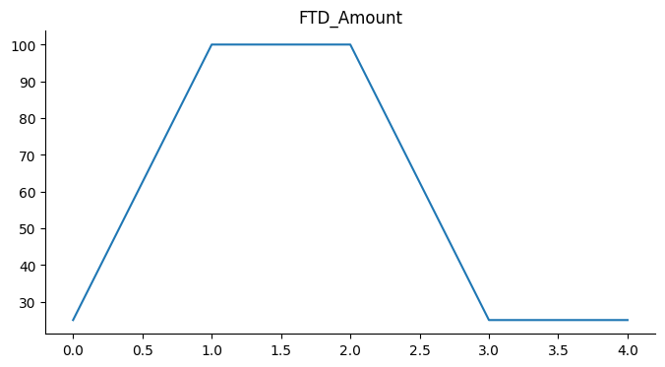
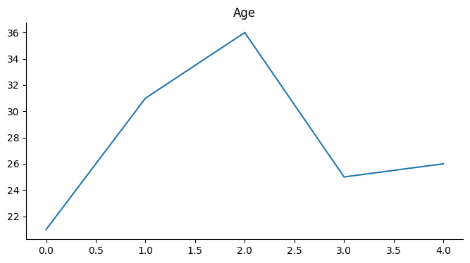
Data Analysis - Trends & Patterns
User Registration Trends: A look into the registration patterns, focusing on dates and user device preferences.

Slide 6
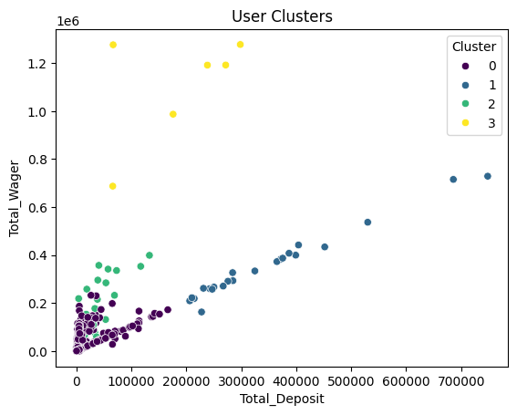
First-Time Deposits (FTD):
Analysis of how FTD correlates with user retention and overall deposit behavior.

Slide 7
Analysis Plots
FTD Amount vs. Age: This scatter plot will examine how users' first-time deposit amounts vary with age. This insight could guide marketing strategies targeted at specific age groups for optimal deposit amounts.
Device Type vs. User Registration Success: A bar chart showing the success rates of user registrations across different devices. This helps understand which platforms provide the best user onboarding experience.

Slide 8
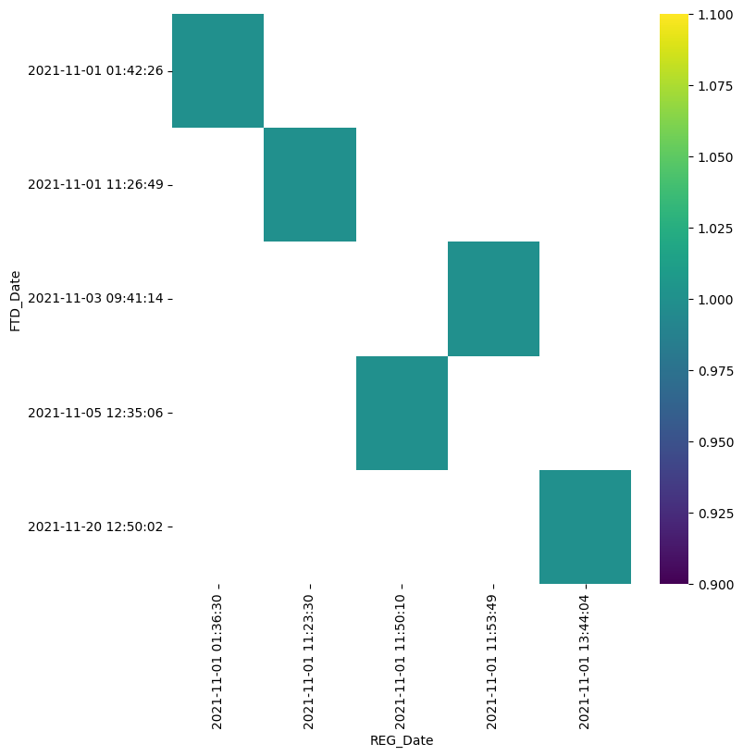
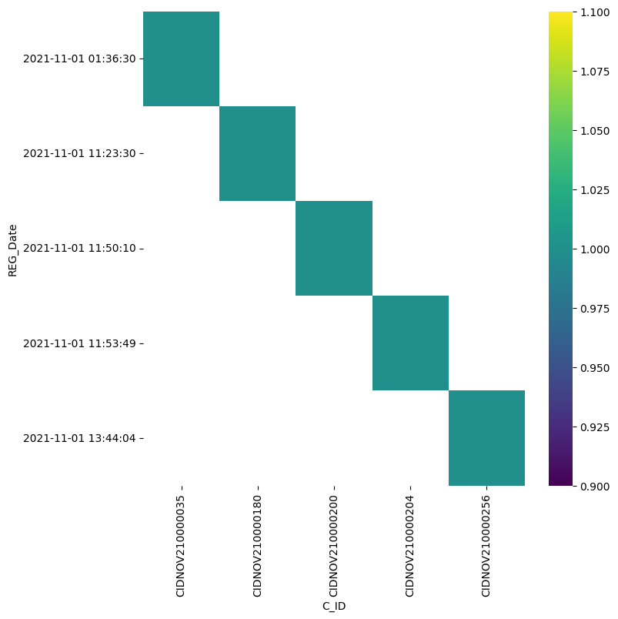
Analyzing these trends helps us understand seasonal patterns and peak registration periods.

Slide 9
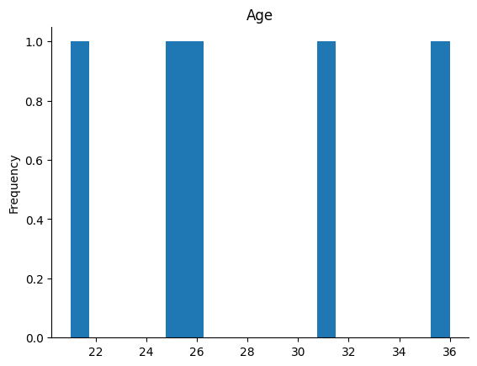
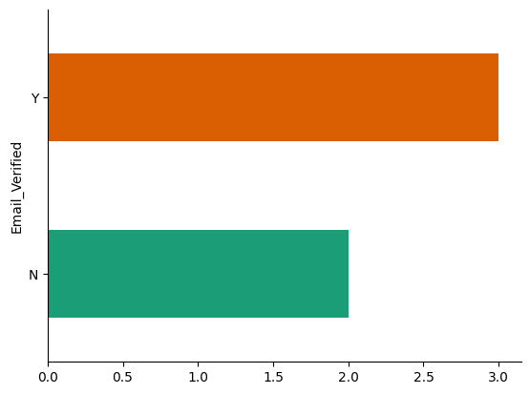
User Registration Date Distribution:
This plot will show the distribution of user registrations over time.

Slide 10
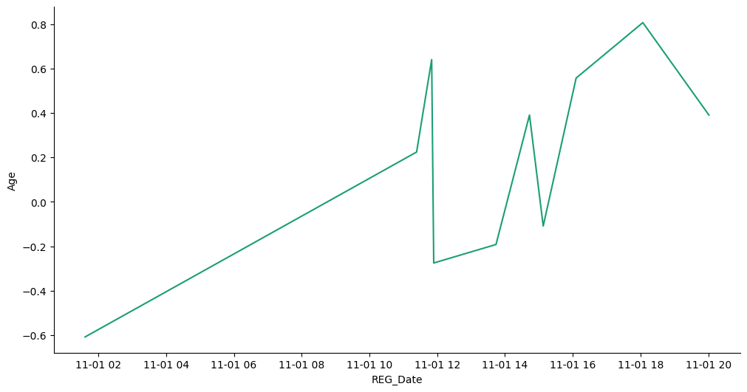
Engagement & Retention Analysis
Engagement Metrics: Analyzing the relationship between total deposits and wagering can help predict the most engaged user segments.

Slide 11
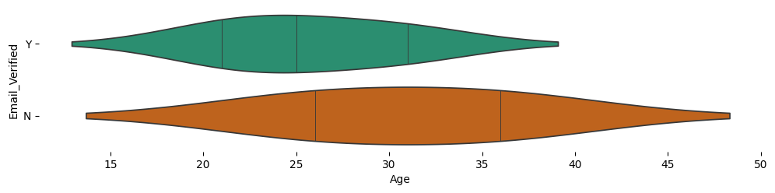
Engagement Analysis Plots
User Retention Based on KYC Completion: A line graph that correlates user retention rates with KYC status completion, suggesting KYC could significantly affect engagement.

Slide 12
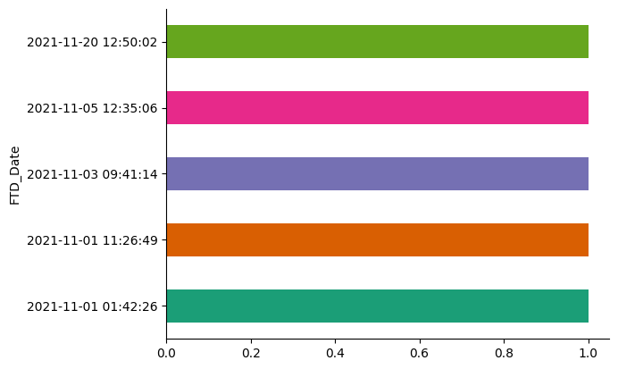
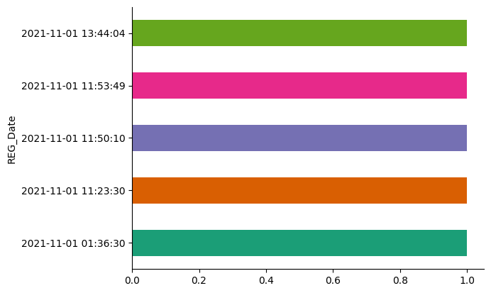
Withdrawals and Wagering Behavior:
A bar chart comparing users’ withdrawals and their wagering behavior to understand the impact on financial forecasting.

Slide 13
Conclusion
The key takeaway is the significant role of device preferences and KYC completion in driving long-term user loyalty.

Slide 14
Thank you!
Mail: personalaccdinesh@gmail.com
Linkedin:DINESH S
View project @GITHUB

